Slide 1
The Railroads The first transcontinental railroad
The American West

Slide 2
The Building of the Railroads
Built in 1860s
Two companies
Central Pacific Railroad Company
Union Pacific Railroad Company
Met and joined railroad in Promontory, Utah
Date of completion 10 May 1869
By 1893 there were 6 major railroad companies

Slide 3
Why did America need Railroads?
Communication from East to West was not very good
Travelling time from East to West took 6 months +
It would help fulfil ‘Manifest Destiny’
The U.S. needed to keep up with other countries
Trade links with China and Japan
Help to bring law and order to the West

Slide 4
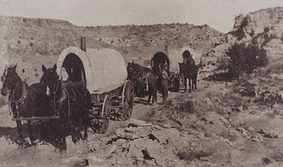
Effect of the Railroads: Quick and easy travel to the West
Previous methods
Wagon Train
Foot
By boat
Pony Express
The railroad turned a 6 month journey into a maximum of 8 days

Slide 5
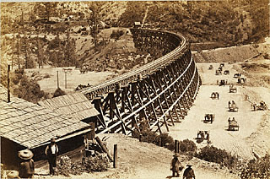
Effect of the Railroads: Cheap land for people wanting to go West
Once the Railroads were built the Railroad companies had no use for the excess land
Sold land off cheap
Benefitted Homesteaders and Ranchers who came west.

Slide 6
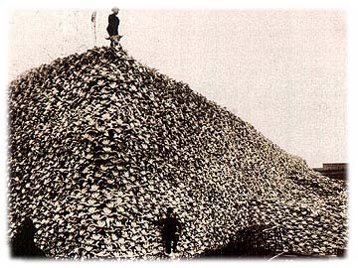
Effect of the Railroads: Destruction of the Indians
Hunters used the Railroad to go west to hunt the buffalo
Hunters were only interested in buffalo skin
1875 southern buffalo herds wiped out
1885 northern buffalo herds wiped out
Indians depended on the buffalo, but now they were gone! ☹

Slide 7
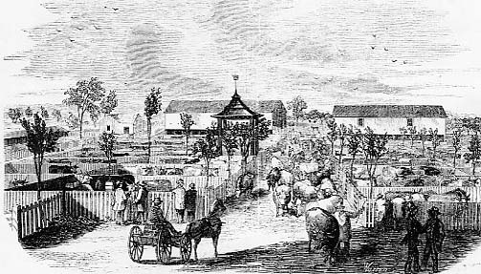
Effect of the Railroads: Helps develop the Cattle Industry
Cattle were transported by the railroads making it easier to move them from Texas to the East
Cow Towns grew up around these railroad stops

Slide 8
Task
Essay Question:
How important were the railroad and railroad companies in opening up the west?
Step 1: Planning your answer
Step 2: Writing your answer

Slide 9
This powerpoint was kindly donated to www.worldofteaching.com
http://www.worldofteaching.com is home to over a thousand powerpoints submitted by teachers. This is a completely free site and requires no registration. Please visit and I hope it will help in your teaching.

